Slide 1
Matt Kennedy, Sr. Product Manager - DataStax
Best Practices for Securing DataStax Enterprise

Slide 2
Finding the right analogy…

Slide 3
https://
Notes:
https://commons.wikimedia.org/wiki/File:Pound_layer_cake.jpg (Public Domain)

Slide 4
https://upload.wikimedia.org/wikipedia/commons/0/04/Pound_layer_cake.jpg
© User:Colin / Wikimedia Commons / CC BY-SA 3.0
Notes:
https://commons.wikimedia.org/wiki/File:Mixed_onions.jpg

Slide 5
Crying Child Image
Notes:
https://https://www.flickr.com/photos/crimfants/327861820/
Author: Crimfants
(https://https://www.flickr.com/photos/crimfants)
Creative Commons Attribution-ShareAlike 2.0

Slide 6

app-tier
DC1
DSE Cluster
https
app-code
driver
mobile/
browser
tls
app-code
driver
[Internet]
DC2
cql+tls
app-code
driver
[App-DMZ]
DevCenter
cql+tls
[Corp-Net]
[DB-Net]
[DBA-VPN]

Slide 7
1 | Network Security
2 | Encryption-At-Rest
3 | Authentication, Authorization & Auditing
4 | Search & Analytics
5 | Additional Strategies

Slide 8
Preparing Certificates
https://docs.datastax.com/en/cassandra/3.0/cassandra/configuration/secureSSLCertificates.html
Also, install the Java Cryptography Extension (JCE) Unlimited Strength Jurisdiction Policy Files

Slide 9
app-tier
DC1
DSE Cluster
https
app-code
driver
mobile/
browser
tls
app-code
driver
[Internet]
DC2
cql+tls
app-code
driver
[App-DMZ]
DevCenter
cql+tls
[Corp-Net]
[DB-Net]
[DBA-VPN]

Slide 10
End User to App Tier
Use HTTPS
Do your homework on user password hash storage:
http://security.blogoverflow.com/2013/09/about-secure-password-hashing/

Slide 11
app-tier
DC1
DSE Cluster
https
app-code
driver
mobile/
browser
tls
app-code
driver
[Internet]
DC2
cql+tls
app-code
driver
[App-DMZ]
DevCenter
cql+tls
[Corp-Net]
[DB-Net]
[DBA-VPN]

Slide 12
Node to Node Encryption
cassandra.yaml
server_encryption_options:
internode_encryption: [none|rack|dc|all]
keystore: resources/dse/conf/.keystore
keystore_password: <keystore password>
truststore: resources/dse/conf/.truststore
truststore_password: <truststore password>
require_client_auth: <true or false>
By default: TLS_RSA_WITH_AES_128_CBC_SHA

Slide 13
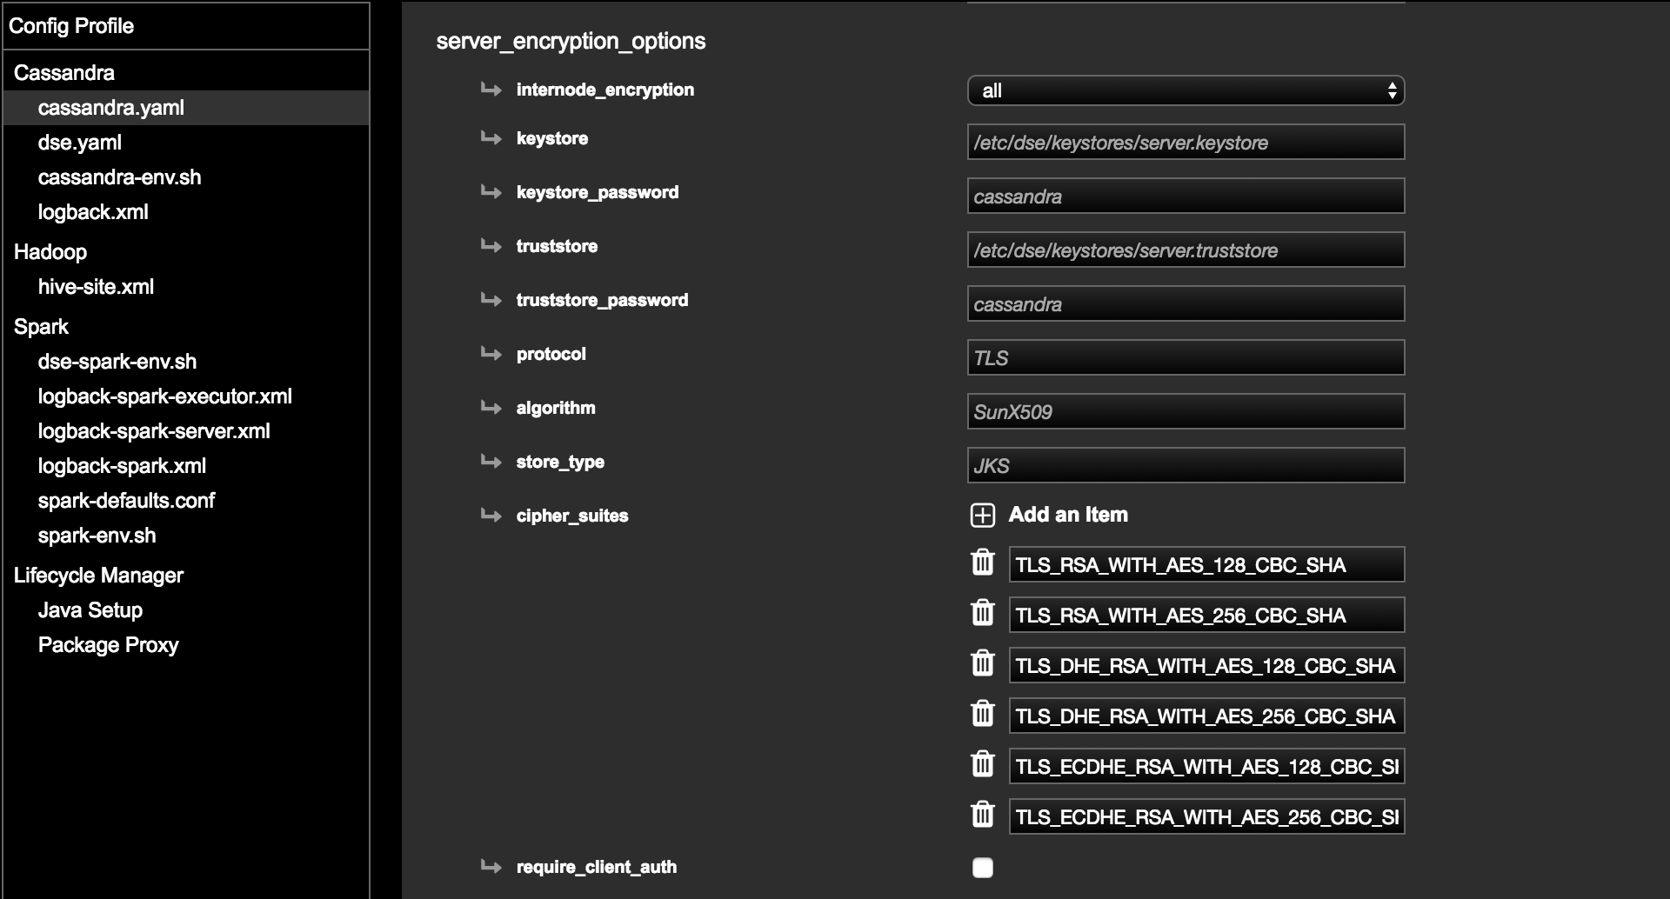
IT SETS UP THE JAVA PKI CERT STUFF FOR YOU!!!

Slide 14
app-tier
DC1
DSE Cluster
https
app-code
driver
mobile/
browser
tls
app-code
driver
[Internet]
DC2
cql+tls
app-code
driver
[App-DMZ]
DevCenter
cql+tls
[Corp-Net]
[DB-Net]
[DBA-VPN]

Slide 15
Client to Node Encryption
(Server Side)
cassandra.yaml
client_encryption_options:
enabled: true
keystore: conf/keystore.node0
keystore_password: cassandra
require_client_auth: true
truststore: conf/truststore.node0
truststore_password: cassandra

Slide 16
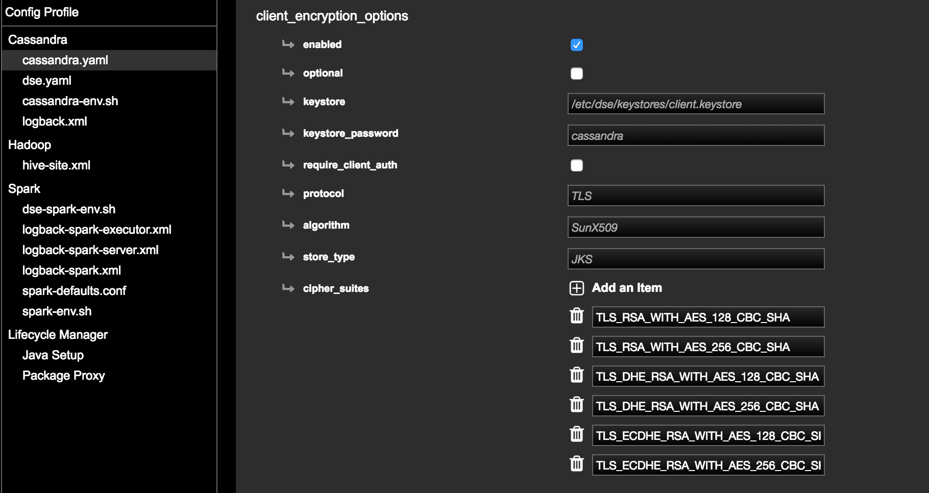

Slide 17
Client to Node Encryption (Client Side)
Client | Docs
cqlsh | https://docs.datastax.com/en/cassandra/3.0/cassandra/configuration/secureCqlshSSL.html
DevCenter | https://www.datastax.com/dev/blog/how-to-connect-devcenter-to-an-ssl-enabled-cassandra-cluster
Java | https://github.com/datastax/java-driver/tree/3.0/manual/ssl
Python | https://datastax.github.io/python-driver/security.html
C/C++ | http://datastax.github.io/cpp-driver/topics/security/ssl/
C# | http://docs.datastax.com/en/latest-csharp-driver-api/html/M_Cassandra_Builder_WithSSL_1.htm
Ruby | http://docs.datastax.com/en/developer/ruby-driver/3.0/features/security/ssl_encryption/

Slide 18
1 | Network Security
2 | Encryption-At-Rest
3 | Authentication, Authorization & Auditing
4 | Search & Analytics
5 | Additional Strategies

Slide 19
app-tier
DC1
DSE Cluster
https
app-code
driver
mobile/
browser
app-code
driver
[Internet]
DC2
app-code
driver
[App-DMZ]
DevCenter
[Corp-Net]
[DB-Net]
[DBA VPN]

Slide 20
Transparent Data Encryption (TDE)
KMIP – Key Management Interoperability Protocol
Standards based OASIS protocol
Stores encryption keys off server
DataStax Tests the Vormetric KMIP server
Two categories of data to encrypt: system files & user data
System: system_info_encryption in dse.yaml
System Tables
Commitlog
Hints
User: Configured on a per-table basis
SSTables
Solr Indexes
Solr Commitlog

Slide 21
!
SSTable Index files are not yet covered by TDE.
Partition keys are present in plaintext.
This would be a reason to consider full disk encryption.

Slide 22
1 | Network Security
2 | Encryption-At-Rest
3 | Authentication, Authorization & Auditing
4 | Search & Analytics
5 | Additional Strategies

Slide 23
Authentication, Authorization & Auditing
Authentication: Who are you?
Authorization: What are you allowed to do?
Auditing: What have you done?!

Slide 24

Authentication

Slide 25
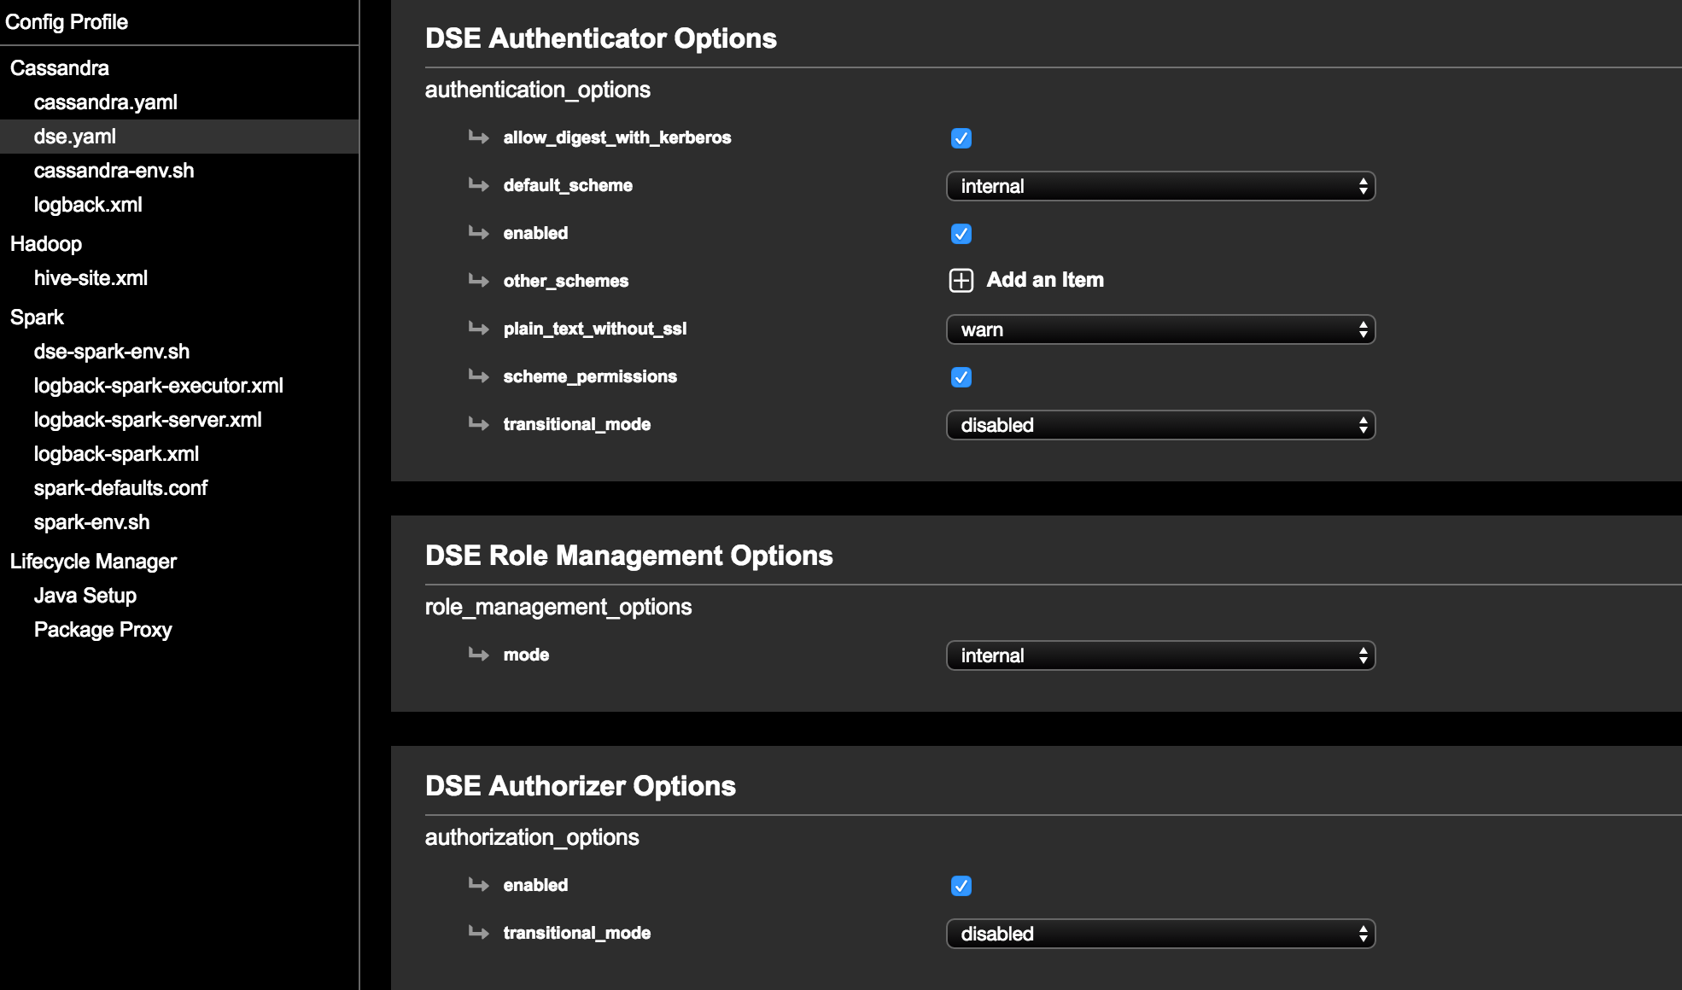

Slide 26
Role Based Access Control (RBAC)
RBAC introduced to OSS C* in v 2.2
RBAC is a mainstay of conventional database security
Roles are assigned database permissions, users are assigned to roles to obtain permissions
admin
alice
bob
role names
bi
bob
charlie
users
Company Confidential

Slide 27
RBAC + LDAP in DSE 5.0
{alice: hasRole:admin}
{bob: hasRole:admin,bi}
{charlie: hasRole:bi}
LDAP
Roles
admin
bi
app
What are the user’s roles?
Notes:
This is what DSE 5.0 has over Open Source Cassandra.
Inherits basic behavior from OSS C*. (assign users to roles in C*)
Adds DSE Role Manager:
Permissions assigned to roles in C*
Users mapped to roles via LDAP/ActiveDirectory

Slide 28
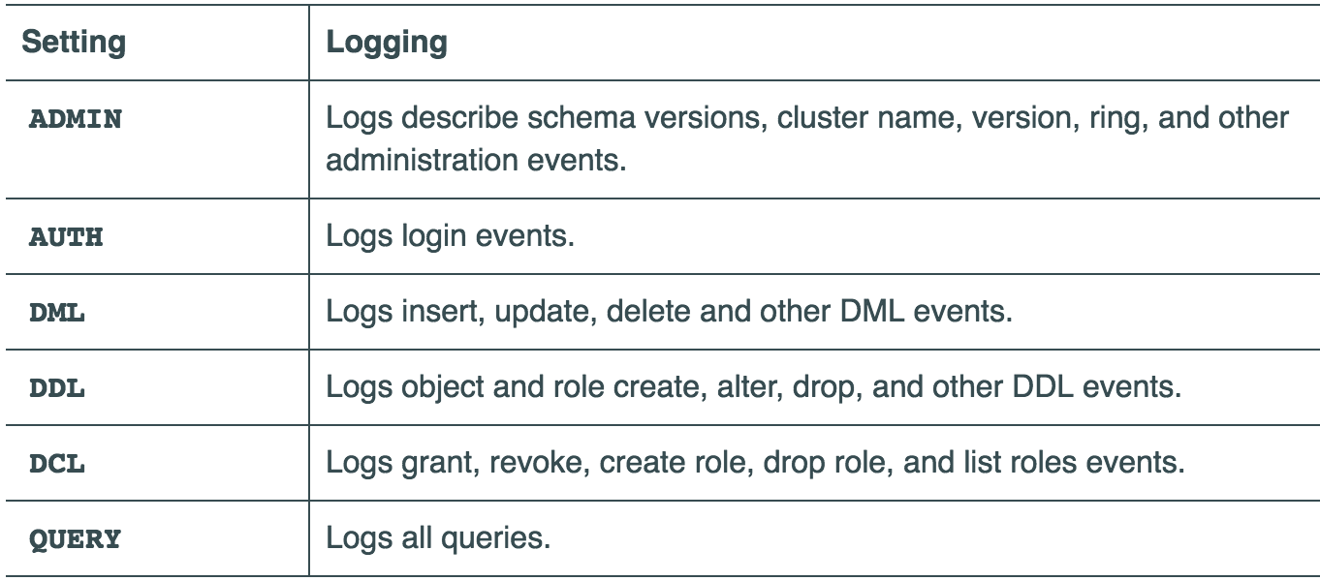
Auditing
Records user activity in the cluster
Per-node config
Can log to a logback file or a table (optionally w/TTL)

Slide 29
Auditing Search
Uncomment in the Tomcat web.xml
<filter-mapping>
<filter-name>DseAuditLoggingFilter</filter-name>
<url-pattern>/*</url-pattern>
</filter-mapping>

Slide 30
1 | Network Security
2 | Encryption-At-Rest
3 | Authentication, Authorization & Auditing
4 | Search & Analytics
5 | Additional Strategies

Slide 31
One more thing about Search…
Use the CQL interface to search for secured clusters
The HTTP endpoint has a known performance degradation when authentication is in use
The above isn’t a huge problem for administrative usage, but could be a problem for application usage

Slide 32
Analytics
In dse.yaml, set:
spark_security_enabled (Authentication)
spark_security_encryption_enabled
Authentication uses Spark shared secrets
https://spark.apache.org/docs/1.6.1/security.html
Jacek’s Talk: Thursday@10AM Advanced DSE analytics client configuration
In DSE, the shared secret is propagated through C* tables.

Slide 33
!
Securing the Spark WebUI is not yet natively supported in DSE.
DSE-FS communication and blocks are not encrypted.

Slide 34
1 | Network Security
2 | Encryption-At-Rest
3 | Authentication, Authorization & Auditing
4 | Search & Analytics
5 | Additional Strategies

Slide 35
Additional Strategies
There will always be more complex security requirements than your database supports
We are working to close the gap, but new security models are always being developed
If you can’t wait, build additional security in the app-tier
Example: Attribute Based Access Control (ABAC)

Slide 36
Example ABAC Requirements
Users have different access levels
Each column may have a different access level
Some columns may have “need to know” requirements
These requirements can be time-boxed and geo-fenced
Column visibility should be based on:
User access level > column level
User’s physical location
User’s “need to know” at a given time of day (during shift, or not?)

Slide 37
Final Hints and Reminders
Don’t forget your history files – cqlsh has a history file!
Bash can be configured to skip recording commands that have a leading space. This can be a huge convenience if you have to pass sensitive info.
chmod 700 is your friend
Be cognizant of process listings
Belts AND Suspenders, you can never be too cautious

Slide 39
UnifiedAuth in DSE 5.0
DSEAuthenticator
Flexibility
Human users have their identities stored in Directory Servers (LDAP & Active Directory).
Application users often aren’t real people (mobileappuser, webtieruser, device_source).

Slide 40
Table Design Style
Content | Content | Content | Content | Content | Content
Content | Content | Content | Content | Content | Content
Content | Content | Content | Content | Content | Content
Content | Content | Content | Content | Content | Content
Content | Content | Content | Content | Content | Content
Content | Content | Content | Content | Content | Content
Content | Content | Content | Content | Content | Content
Content | Content | Content | Content | Content | Content

